Slide 1
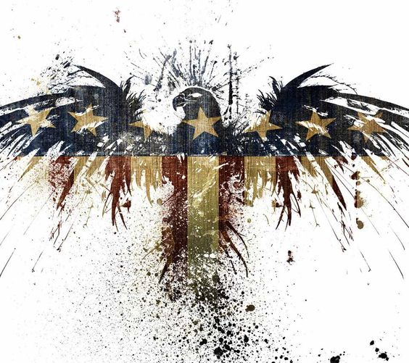
The presidential Analysis
By Group 7
1.Nishant Sharma 2.Karthik Raman 3.Aditi Mukherjee
4.Nandkishor Patil

Slide 2

Data Overview
The analysis primarily consists of three Datasets-
1.Presidential Polls
This dataset is a collection of state and national polls conducted from November 2015-November 2016 on the 2016 presidential election.
Data on the raw and weighted poll results by state, date, pollster, and pollster ratings are included.
This contains 27 relevant socio geographical survey variables.
The original dataset is from the FiveThirtyEight 2016 Election Forecast. Poll results were aggregated from HuffPost Pollster, RealClearPolitics, polling firms and news reports.

Slide 3
Data Overview:
2. Primary Results-
This contains data relevant for the 2016 US Presidential Election, including up-to-date primary results of 8 variables. Each row contains the votes and fraction of votes that a candidate received in a given county's primary.
3. County table-
This contains categories such as population, age groups,race,gender,income,education by each county.

Slide 4
PROBLEM STATEMENTS AND OBJECTIVES
Which are the major contributors towards the Adjusted Poll Prediction of the winner of Presidential Election 2016?
Checking non variance and biasness of the survey.
Which variables are major contributors towards a county voting for a particular party?
Predicting and selecting best model for who will win a county based on demographics
Random Forest.
Naïve Baye’s.
A correct prediction from the big-name surveys from simple mathematics (Surprise Analysis?)
Which model classifies best the winner class for Presidential Polls Survey?
Neural Networks
Naïve Baye’s.

Slide 5
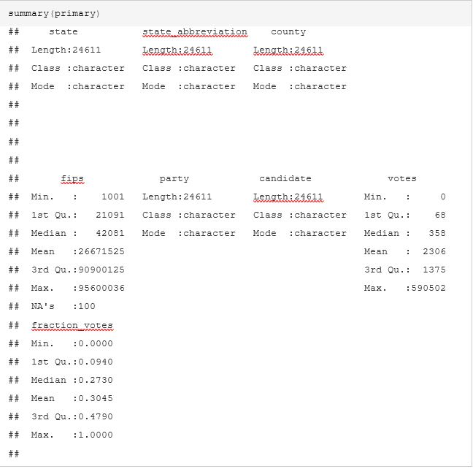
STATISTICAL INTERPRETATION
5 Number summary for Primary Results dataset-

Slide 6
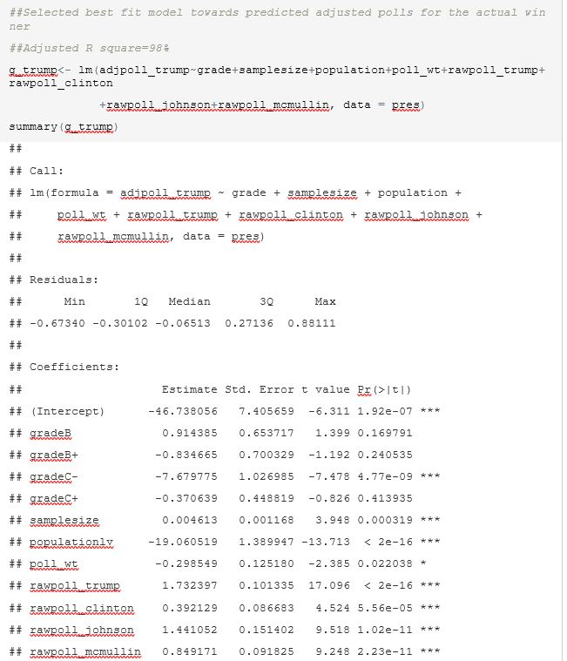
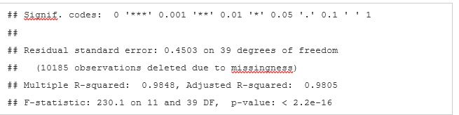
STATISTICAL INTERPRETATION
Best Fit Regression model for Surveyor’s opinion on Adjusted Trump Poll

Slide 7
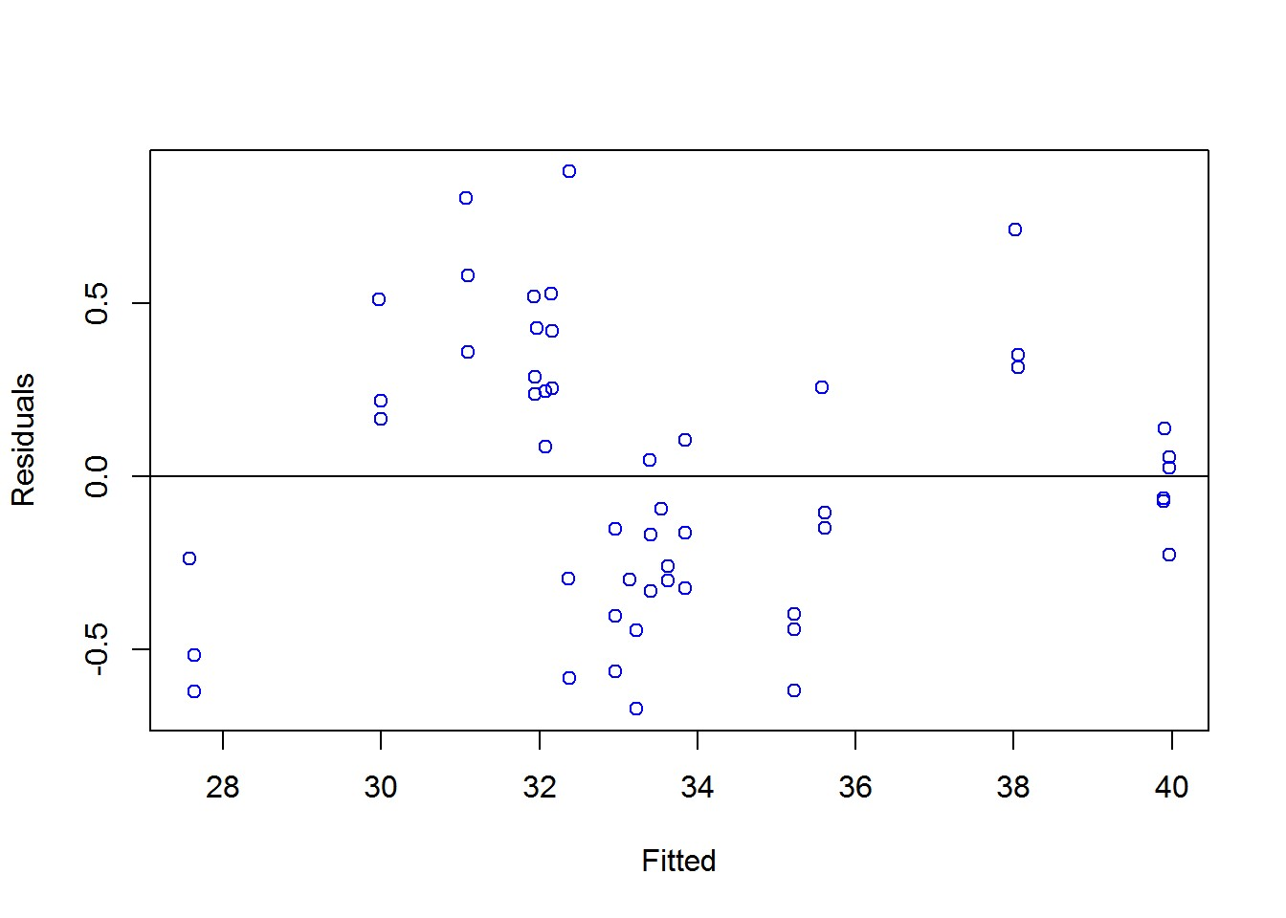
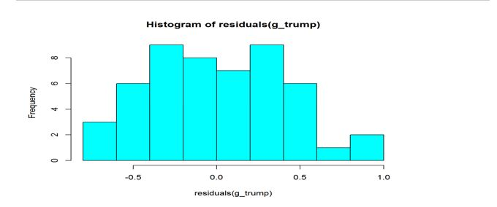
STATISTICAL INTERPRETATION
Residue Fitted Plot for our model:

Slide 8
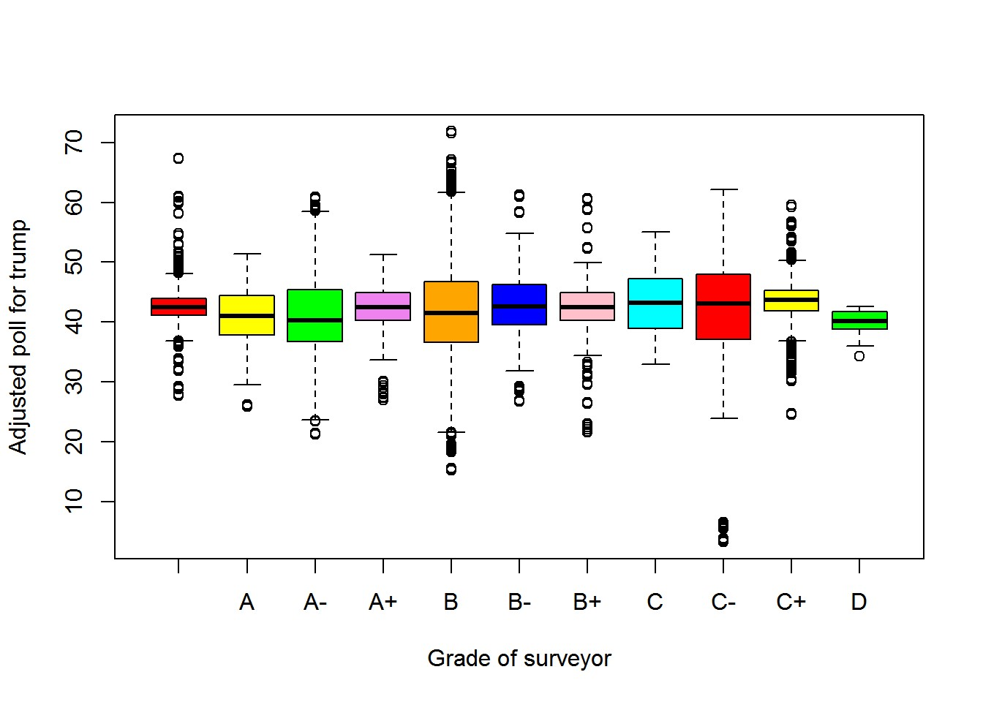
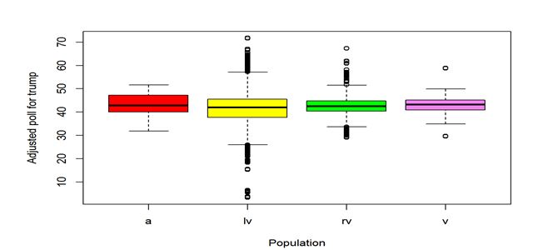
STATISTICAL INTERPRETATION
Detecting Outliers in the dataset:
--With respect to prior grades of surveyors
--With respect to population

Slide 9
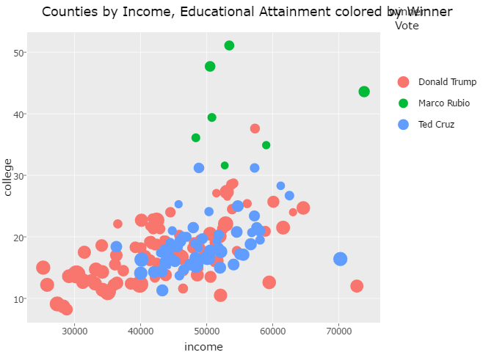
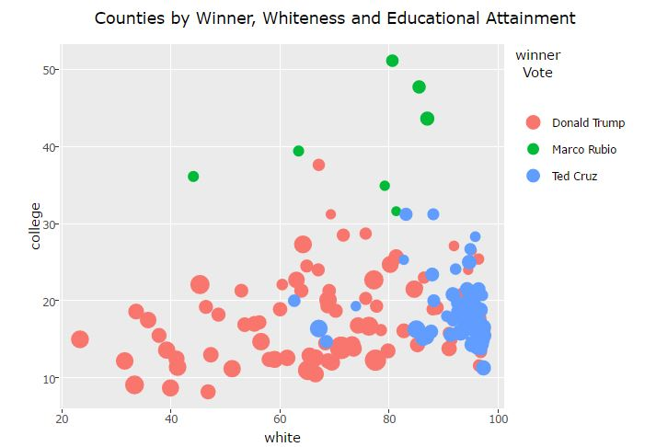
CLASSIFICATION ANALYSIS OF PRIMARIES
2.)Applying Naïve Bayes Classifier:
→Using :winner ~ income + hispanic + white + college + density.

Slide 10
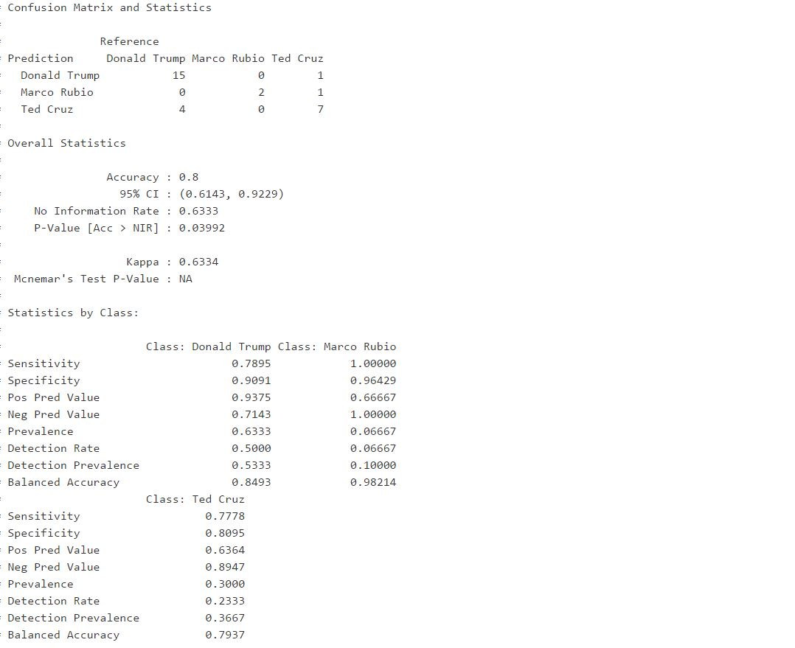
CLASSIFICATION ANALYSIS OF PRIMARIES
Confusion matrix:
2.)Applying Naïve Bayes Classifier:
→Using :winner ~ income + hispanic + white + college + density.

Slide 11
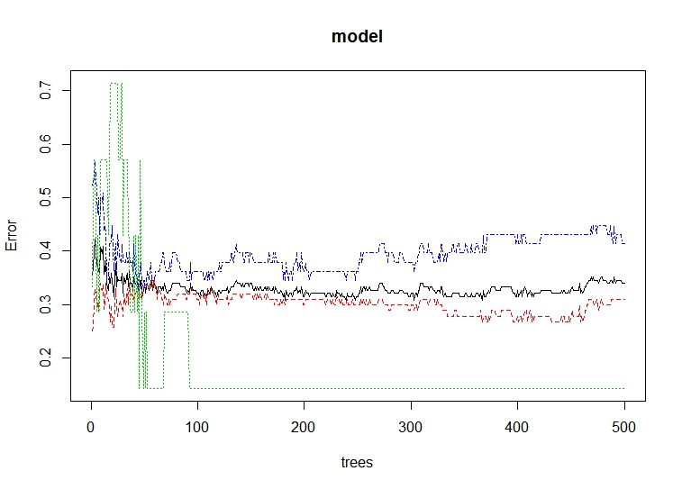
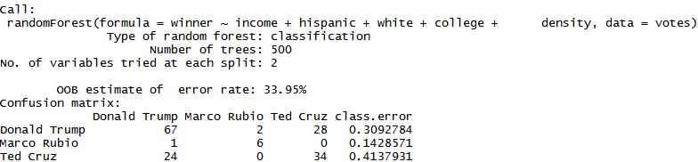
CLASSIFICATION ANALYSIS OF PRIMARIES
1.)Applying Random forest:
→Using :winner ~ income + hispanic + white + college + density.
→it has as roughly 70% accuracy.
→The blue line represent the error for Cruz, red is Trump and green is Rubio. Rubio’s errors are more erratic since we only have a few datapoints for him.
Confusion matrix:

Slide 12
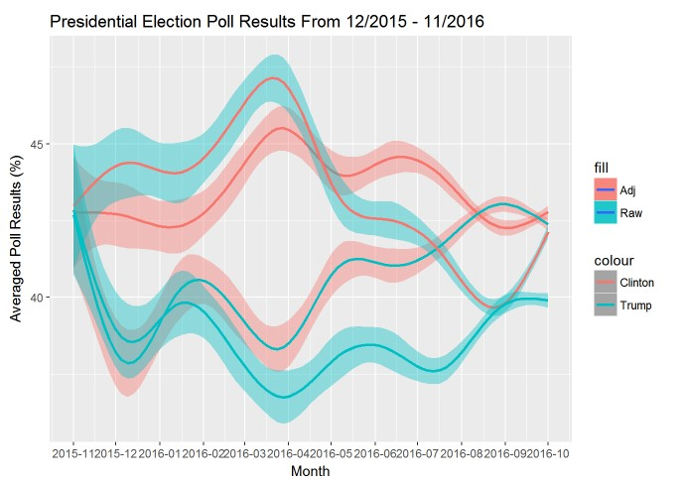
ANALYSIS INSIGHTS AND GRAPHS
1.)Raw VS Adjusted Polls over time:
→Clintons adjustments were much higher.

Slide 13
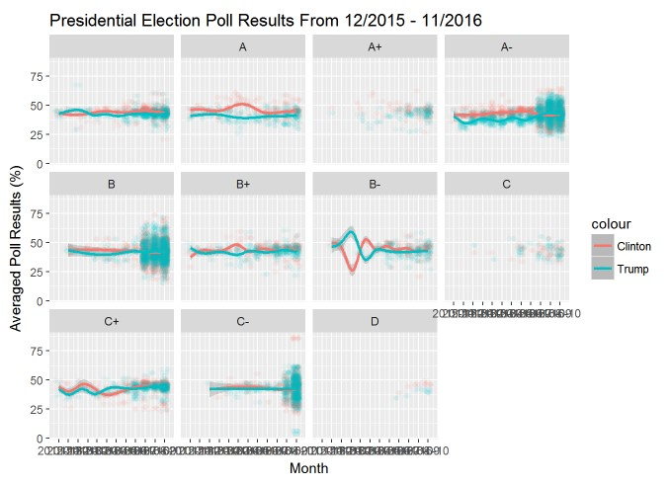
ANALYSIS INSIGHTS AND GRAPHS
2.) Polling with respect to surveyors(grade wise):
→Lower grade pollsters were better at predicting, perhaps due to their lower adjustments.

Slide 14
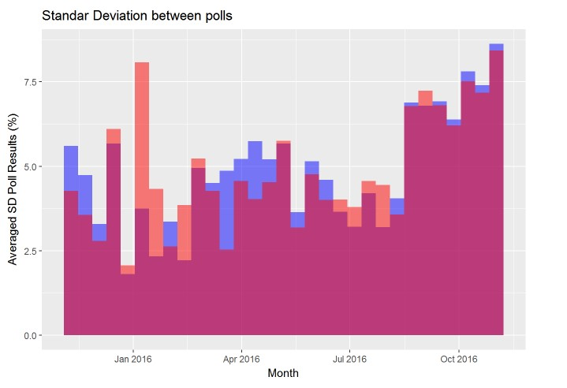
ANALYSIS INSIGHTS AND GRAPHS
3.)Standard Deviation between polls:
→High Standard deviation for both.

Slide 15
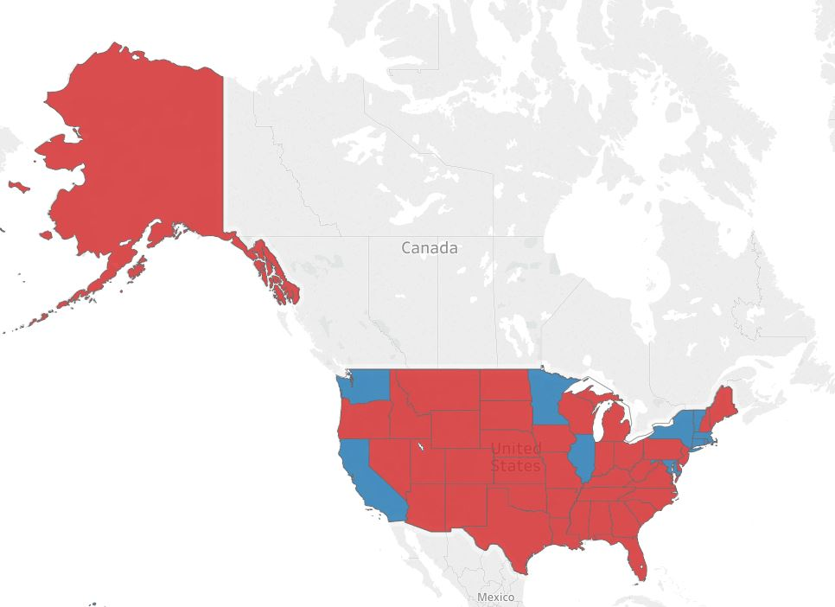
Predictive Analysis
Here in order to predict whose winning from each pollster our dataset we used a simple formula:
If(adjClinton-adjTrump)>0 then make the “winner "column as Clinton, Else Trump.
Correctness of the formula is confirmed by this map.
Trump
Clinton

Slide 16
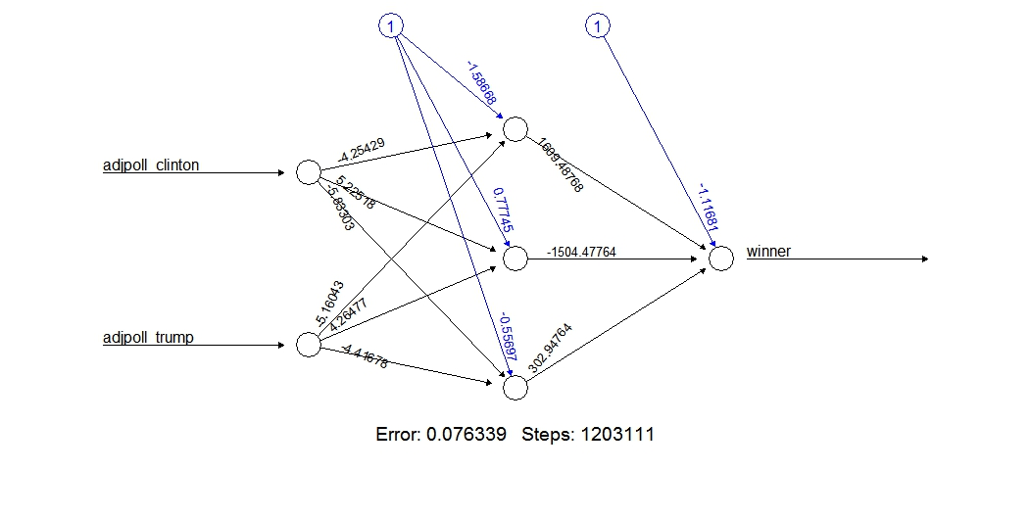
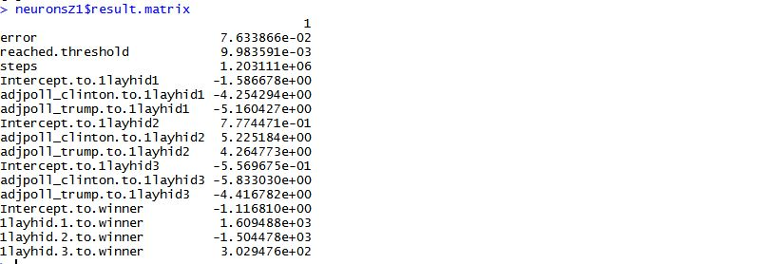

Predictive Analysis:
Finding the best model for classification ?
1.) Applying Neural Networks to Presidential Data for our Formula:
→Two input nodes,
→stepmax to 1e9
→Single hidden layer(3 nodes).
→Trainset(70% of data).
→Testset(30% of data)
Confusion matrix:
Result: Ann is not efficient for classification as it only predicts partially.

Slide 17
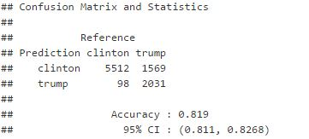
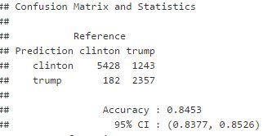
Predictive Analysis:
Confusion matrix for naïve bayes:
Finding the best model for classification ?
2.) Applying Naïve Baye’s to Presidential Data for our Formula:
→Folds=10,Trainset(90%),test(10%).
→82% accuracy
Confusion matrix for SVM’s:
3.) Applying Support Vector Machine’s:
→Folds=10,Trainset(90%),test(10%).
→84.5% accuracy

Slide 18
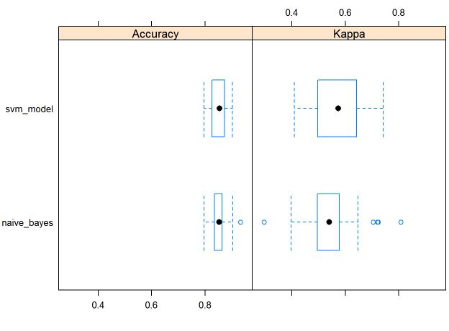

Predictive Analysis: (extended)
Box and Whisker Plots
Svm’s have the highest mean accuracy

Slide 19
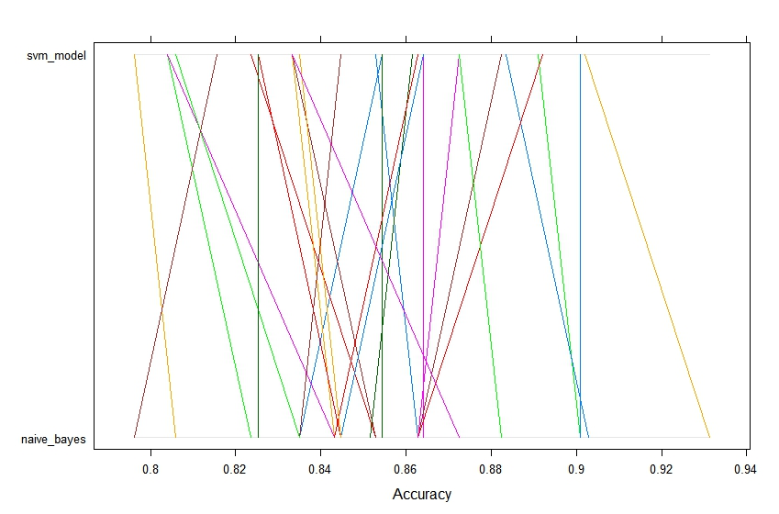
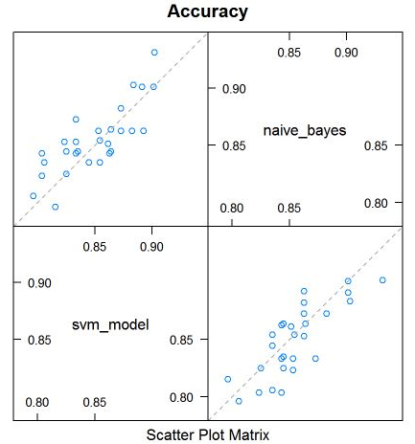
Parallel Plots:
Predictive Analysis: (extended)
Scatterplot Matrix
1.) Each trial of each cross validation fold behaved for svm and naïve bayes in a random manner.
2.)Svm and naïve bayes are strongly correlated to a certain extent.

Slide 20
Conclusion
The Adjusted Poll was mostly influenced by the grade of the surveyor, population type, sample size and poll weightage apart from the raw poll counts.
Surprisingly lower grade surveyors and v type populations consistently predicted the actual winner in most cases.
3. We ran two classification models to see which variables are major contributors in primaries and the main takeaway however is, Donald Trump seems to have a much broader appeal than his two main rivals, at least among Republican primary voters and he is most successful in counties that have:
low median income
low college attainment
large(er) hispanic population.
4. Higher Adjustment in votes for Clinton than trump, perhaps due to media bias.
5. Formulation of class labels which match the final outcome of the 2016 election results, using adjusted votes.
6. Using the above prediction formula we used three classifiers to find the best result, and concluded that naïve Bayes and SVM’s both works quite efficiently in prediction on test set.

